Slide 1
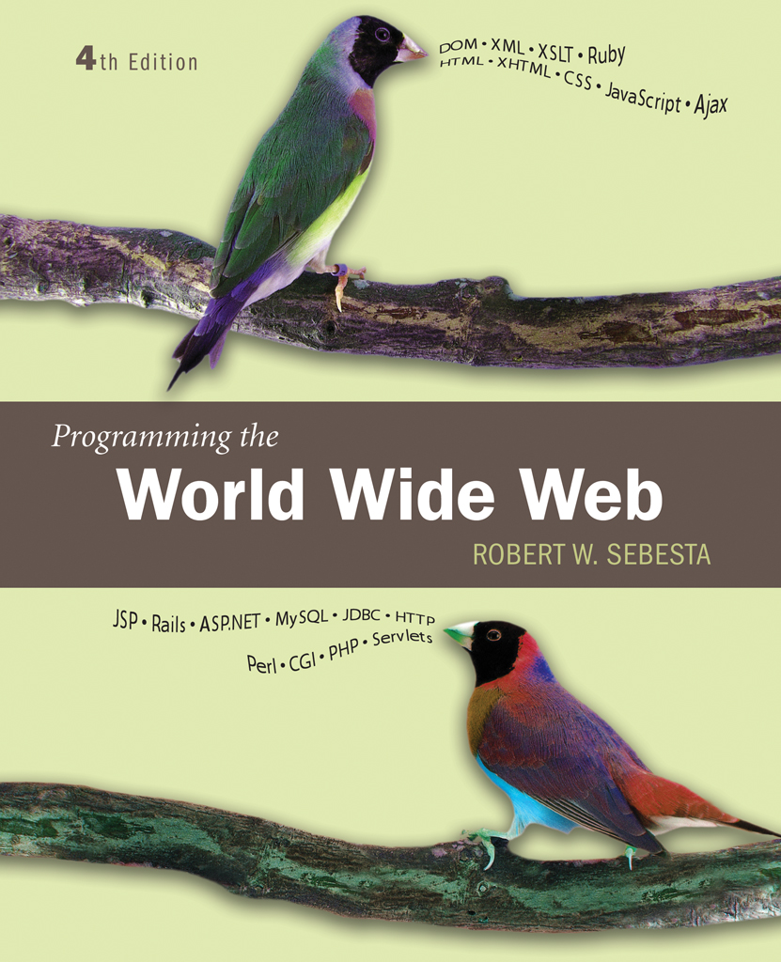
Chapter 4
Basics of
JavaScript

Slide 2
JavaScript/EcmaScript References
The official EcmaScript, third edition, specification
  http://www.ecma-international.org/publications/files/ECMA-ST/Ecma-262.pdf
A working version of the 4th edition of the EcmaScript language specification
  http://www.carsoncheng.com/Ecma/tc39-tg1-2006-001.pdf
JavaScript as implemented in Mozilla products
  http://developer.mozilla.org/en/docs/JavaScript

Slide 3
4.1 Overview of JavaScript: Origins
Originally developed by Netscape
Joint Development with Sun Microsystems in 1995
Standard 262 (ECMA-262) of the European Computer Manufacturers Association
ECMA-262 edition 3 is the current standard
  Edition 4 is under development
Supported by Netscape, Mozilla, Internet Exploer

Slide 4
4.1 JavaScript Components
Core
  The heart of the language
Client-side
  Library of objects supporting browser control and user interaction
Server-side
  Library of objects that support use in web servers
Text focuses on Client-side

Slide 5
4.1 Java and JavaScript
Differences
  JavaScript has a different object model from Java
  JavaScript is not strongly typed
Java 1.6 has support for scripting
  http://java.sun.com/javase/6/docs/technotes/guides/scripting/index.html
Mozilla Rhino is an implementation of JavaScript in Java
  http://www.mozilla.org/rhino/

Slide 6
4.1 Uses of JavaScript
Provide alternative to server-side programming
  Servers are often overloaded
  Client processing has quicker reaction time
JavaScript can work with forms
JavaScript can interact with the internal model of the web page (Document Object Model)
JavaScript is used to provide more complex user interface than plain forms with HTML/CSS can provide
  http://www.protopage.com/ is an interesting example
  A number of toolkits are available. Dojo, found at http://dojotoolkit.org/, is one example

Slide 7
4.1 Event-Driven Computation
Users actions, such as mouse clicks and key presses, are referred to as events
The main task of most JavaScript programs is to respond to events
For example, a JavaScript program could validate data in a form before it is submitted to a server
  Caution: It is important that crucial validation be done by the server. It is relatively easy to bypass client-side controls
  For example, a user might create a copy of a web page but remove all the validation code.

Slide 8
4.1 XHTML/JavaScript Documents
When JavaScript is embedded in an XHTML document, the browser must interpret it
Two locations for JavaScript server different purposes
  JavaScript in the head element will react to user input and be called from other locations
  JavaScript in the body element will be executed once as the page is loaded
Various strategies must be used to ‘protect’ the JavaScript from the browser
  For example, comparisons present a problem since < and > are used to mark tags in XHTML
  JavaScript code can be enclosed in XHTML comments
  JavaScript code can be enclosed in a CDATA section

Slide 9
4.2 Object Orientation and JavaScript
JavaScript is object-based
  JavaScript defines objects that encapsulate both data and processing
  However, JavaScript does not have true inheritance nor subtyping
JavaScript provides prototype-based inheritance
  See, for example this Wikipedia article for a discussion:
  http://en.wikipedia.org/wiki/Prototype-based_languages

Slide 10
4.2 JavaScript Objects
Objects are collections of properties
Properties are either data properties or method properties
Data properties are either primitive values or references to other objects
Primitive values are often implemented directly in hardware
The Object object is the ancestor of all objects in a JavaScript program
  Object has no data properties, but several method properties

Slide 11
4.3 JavaScript in XHTML
Directly embedded
  <script type=“text/javascript”>
  <!--
  …Javascript here…
  -->
  </script>
  However, note that a-- will not be allowed here!
Indirect reference
  <script type=“text/javascript” src=“tst_number.js”/>
  This is the preferred approach

Slide 12
4.3 JavaScript in XHTML: CDATA
The <![CDATA[ … ]]> block is intended to hold data that should not be interpreted as XHTML
Using this should allow any data (including special symbols and --) to be included in the script
This, however does not work, at least in Firefox:
  <script type=“text/javascript”>
  <![CDATA[
  …JavaScript here…
  ]]>
  </script>
The problem seems to be that the CDATA tag causes an internal JavaScript error

Slide 13
4.3 JavaScript in XHTML
This does work in Firefox
  <script type=“text/javascript”>
  /*<![CDATA[ */
  …JavaScript here…
  /*]]> */
  </script>
The comment symbols do not bother the XML parser (only /* and */ are ‘visible’ to it)
The comment symbols protect the CDATA markers from the JavaScript parser

Slide 14
4.3 General Syntactic Characteristics
Identifiers
  Start with $, _, letter
  Continue with $, _, letter or digit
  Case sensitive
Reserved words
Comments
  //
  /* … */

Slide 15
4.3 Statement Syntax
Statements can be terminated with a semicolon
However, the interpreter will insert the semicolon if missing at the end of a line and the statement seems to be complete
Can be a problem:
  return
  x;
If a statement must be continued to a new line, make sure that the first line does not make a complete statement by itself
Example hello.html

Slide 16
4.4 Primitive Types
Five primitive types
  Number
  String
  Boolean
  Undefined
  Null
There are five classes corresponding to the five primitive types
  Wrapper objects for primitive values
  Place for methods and properties relevant to the primitive types
  Primitive values are coerced to the wrapper class as necessary, and vice-versa

Slide 17
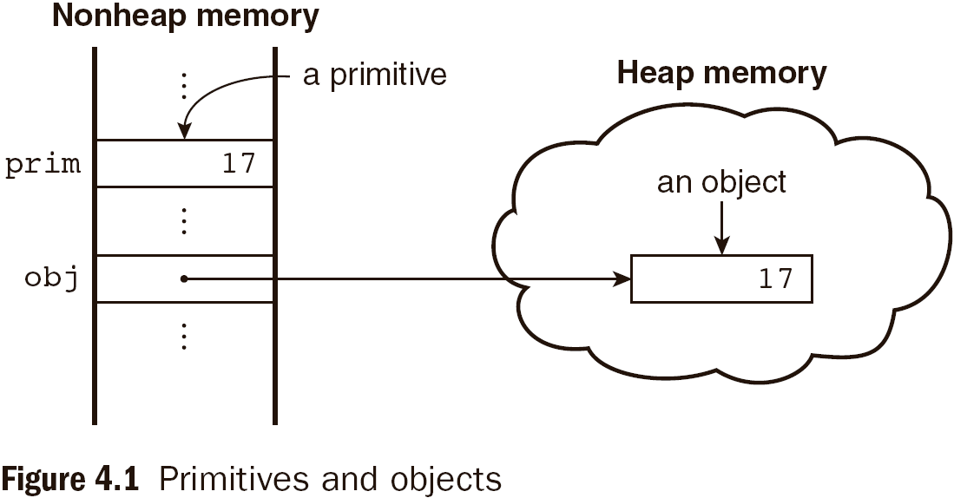
4.4 Primitive and Object Storage

Slide 18
4.4 Numeric and String Literals
Number values are represented internally as double-precision floating-point values
  Number literals can be either integer or float
  Float values may have a decimal and/or and exponent
A String literal is delimited by either single or double quotes
  There is no difference between single and double quotes
  Certain characters may be escaped in strings
    \’ or \” to use a quote in a string delimited by the same quotes
    \\ to use a literal backspace
  The empty string ‘’ or “” has no characters

Slide 19
4.4 Other Primitive Types
Null
  A single value, null
  null is a reserved word
  A variable that is used but has not been declared nor been assigned a value has a null value
  Using a null value usually causes an error
Undefined
  A single value, undefined
  However, undefined is not, itself, a reserved word
  The value of a variable that is declared but not assigned a value
Boolean
  Two values: true and false

Slide 20
4.4 Declaring Variables
JavaScript is dynamically typed, that is, variables do not have declared types
  A variable can hold different types of values at different times during program execution
A variable is declared using the keyword var
  var counter,
  index,
  pi = 3.14159265,
  quarterback = "Elway",
  stop_flag = true;

Slide 21
4.4 Numeric Operators
Standard arithmetic
  + * - / %
Increment and decrement
  -- ++
  Increment and decrement differ in effect when used before and after a variable
  Assume that a has the value 3, initially
  (++a) * 3 has the value 24
  (a++) * 3 has the value 27
  a has the final value 8 in either case

Slide 22
4.4 Precedence of Operators
Operators | Associativity
++, --, unary - | Right
*, /, % | Left
+, - | Left
>, <, >= ,<= | Left
==, != | Left
===,!== | Left
&& | Left
|| | Left
=, +=, -=, *=, /=, &&=, ||=, %= | Right

Slide 23
4.4 Example of Precedence
var a = 2,
b = 4,
c,
d;
c = 3 + a * b;
// * is first, so c is now 11 (not 24)
d = b / a / 2;
// / associates left, so d is now 1 (not 4)

Slide 24
4.4 The Math Object
Provides a collection of properties and methods useful for Number values
This includes the trigonometric functions such as sin and cos
When used, the methods must be qualified, as in Math.sin(x)

Slide 25
4.4 The Number Object
Properties
  MAX_VALUE
  MIN_VALUE
  NaN
  POSITIVE_INFINITY
  NEGATIVE_INFINITY
  PI
Operations resulting in errors return NaN
  Use isNaN(a) to test if a is NaN
toString method converts a number to string

Slide 26
4.4 String Catenation
The operation + is the string catenation operation
In many cases, other types are automatically converted to string

Slide 27
4.4 Implicit Type Conversion
JavaScript attempts to convert values in order to be able to perform operations
“August “ + 1977 causes the number to be converted to string and a concatenation to be performed
7 * “3” causes the string to be converted to a number and a multiplication to be performed
null is converted to 0 in a numeric context, undefined to NaN
0 is interpreted as a Boolean false, all other numbers are interpreted a true
The empty string is interpreted as a Boolean false, all other strings (including “0”!) as Boolean true
undefined, Nan and null are all interpreted as Boolean false

Slide 28
4.4 Explicit Type Conversion
Explicit conversion of string to number
  Number(aString)
  aString – 0
  Number must begin the string and be followed by space or end of string
parseInt and parseFloat convert the beginning of a string but do not cause an error if a non-space follows the numeric part

Slide 29
4.4 String Properties and Methods
One property: length
  Note to Java programmers, this is not a method!
Character positions in strings begin at index 0

Slide 30
4.4.11 String Methods
Method | Parameters | Result
charAt | A number | Returns the character in the String object that is at the specified position
indexOf | One-character string | Returns the position in the String object of the parameter
substring | Two numbers | Returns the substring of the String object from the first parameter position to the second
toLowerCase | None | Converts any uppercase letters in the string to lowercase
toUpperCase | None | Converts any lowercase letters in the string to uppercase

Slide 31
4.4 The typeof Operator
Returns “number” or “string” or “boolean” for primitive types
Returns “object” for an object or null
Two syntactic forms
  typeof x
  typeof(x)

Slide 32
4.4 Assignment Statements
Plain assignment indicated by =
Compound assignment with
  += -= /= *= %= …
a += 7 means the same as
a = a + 7

Slide 33
4.4 The Date Object
A Date object represents a time stamp, that is, a point in time
A Date object is created with the new operator
  var now= new Date();
  This creates a Date object for the time at which it was created

Slide 34
4.4 The Date Object: Methods
toLocaleString | A string of the Date information
getDate | The day of the month
getMonth | The month of the year, as a number in the range of 0 to 11
getDay | The day of the week, as a number in the range of 0 to 6
getFullYear | The year
getTime | The number of milliseconds since January 1, 1970
getHours | The number of the hour, as a number in the range of 0 to 23
getMinutes | The number of the minute, as a number in the range of 0 to 59
getSeconds | The number of the second, as a number in the range of 0 to 59
getMilliseconds | The number of the millisecond, as a number in the range of 0 to 999

Slide 35
4.5 Window and Document
The Window object represents the window in which the document containing the script is being displayed
The Document object represents the document being displayed using DOM
Window has two properties
  window refers to the Window object itself
  document refers to the Document object
The Window object is the default object for JavaScript, so properties and methods of the Window object may be used without qualifying with the class name

Slide 36
4.5 Screen Output and Keyboard Input
Standard output for JavaScript embedded in a browser is the window displaying the page in which the JavaScript is embedded
The write method of the Document object write its parameters to the browser window
The output is interpreted as HTML by the browser
If a line break is needed in the output, interpolate <br/> into the output

Slide 37
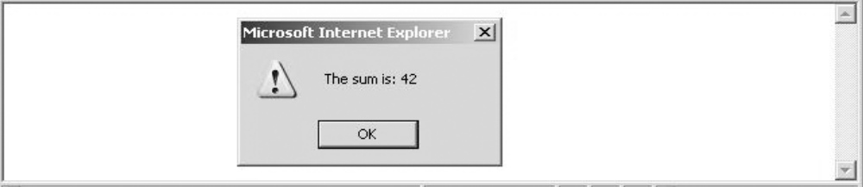
4.5 The alert Method
The alert method opens a dialog box with a message
The output of the alert is not XHTML, so use new lines rather than <br/>
alert("The sum is:" + sum + "\n");

Slide 38
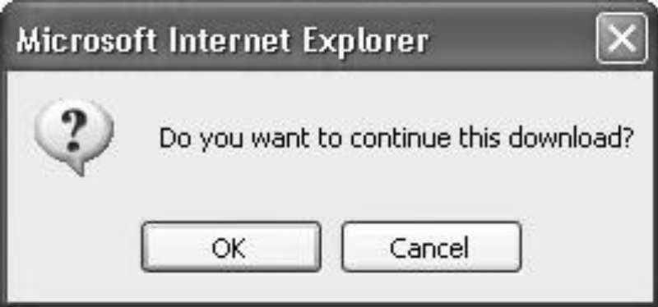
4.5 The confirm Method
The confirm methods displays a message provided as a parameter
  The confirm dialog has two buttons: OK and Cancel
If the user presses OK, true is returned by the method
If the user presses Cancel, false is returned
var question =
confirm("Do you want to continue this download?");

Slide 39
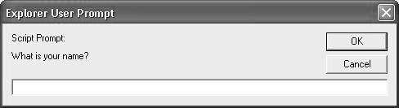
4.5 The prompt Method
This method displays its string argument in a dialog box
  A second argument provides a default content for the user entry area
The dialog box has an area for the user to enter text
The method returns a String with the text entered by the user
name = prompt("What is your name?", "");

Slide 40
4.5 Example of Input and Output
roots.html

Slide 41
4.6 Control Statements
A compound statement in JavaScript is a sequence of 0 or more statements enclosed in curly braces
  Compound statements can be used as components of control statements allowing multiple statements to be used where, syntactically, a single statement is specified
A control construct is a control statement including the statements or compound statements that it contains

Slide 42
4.6 Control Expressions
A control expression has a Boolean value
  An expression with a non-Boolean value used in a control statement will have its value converted to Boolean automatically
Comparison operators
  == != < <= > >=
  === compares identity of values or objects
  3 == ‘3’ is true due to automatic conversion
  3 === ‘3’ is false
Boolean operators
  && || !
Warning! A Boolean object evaluates as true
  Unless the object is null or undefined

Slide 43
4.6 Selection Statements
The if-then and if-then-else are similar to that in other programming languages, especially C/C++/Java

Slide 44
4.6 switch Statement Syntax
switch (expression) {
case value_1:
// statement(s)
case value_2:
// statement(s)
...
[default:
// statement(s)]
}

Slide 45
4.6 switch Statement Semantics
The expression is evaluated
The value of the expressions is compared to the value in each case in turn
If no case matches, execution begins at the default case
Otherwise, execution continues with the statement following the case
Execution continues until either the end of the switch is encountered or a break statement is executed

Slide 46
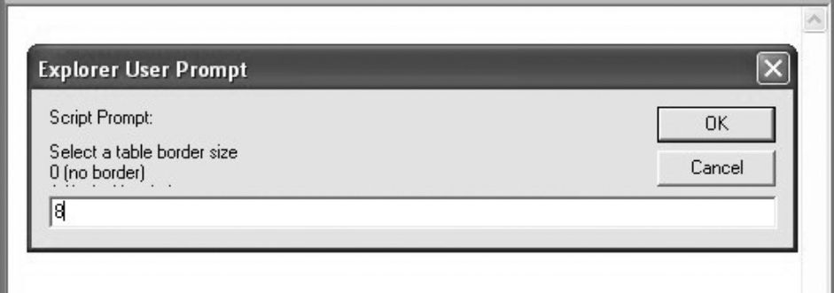
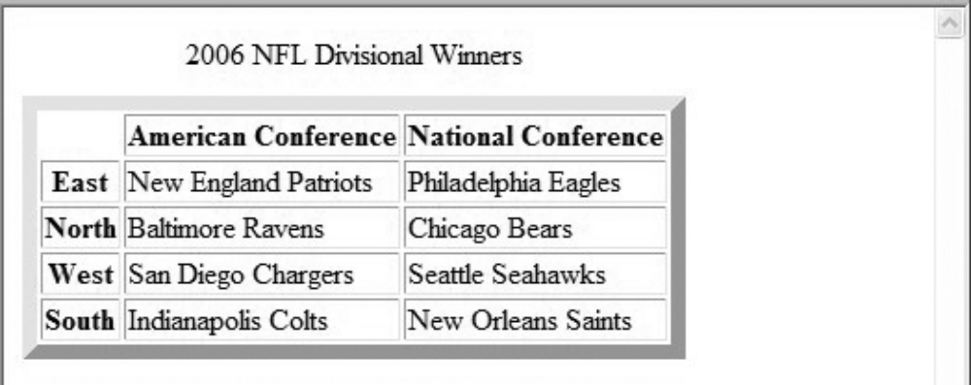
4.6 Example borders2.js
User Input Prompt
Results

Slide 47
4.6 Loop Statements
Loop statements in JavaScript are similar to those in C/C++/Java
While
  while (control expression)
  statement or compound statement
For
  for (initial expression; control expression; increment expression)
  statement or compound statement
do/while
  do statement or compound statement
  while (control expression)

Slide 48
4.6 date.js Example
Uses Date objects to time a calculation
Displays the components of a Date object
Illustrates a for loop

Slide 49
4.6 while Statement Semantics
The control expression is evaluated
If the control expression is true, then the statement is executed
These two steps are repeated until the control expression becomes false
At that point the while statement is finished

Slide 50
4.6 for Statement Semantics
The initial expression is evaluated
The control expression is evaluated
If the control expression is true, the statement is executed
Then the increment expression is evaluated
The previous three steps are repeated as long as the control expression remains true
When the control expression becomes false, the statement is finished executing

Slide 51
4.6 do/while Statement Semantics
The statement is executed
The control expression is evaluated
If the control expression is true, the previous steps are repeated
This continues until the control expression becomes false
At that point, the statement execution is finished

Slide 52
4.7 Object Creation and Modification
The new expression is used to create an object
  This includes a call to a constructor
  The new operator creates a blank object, the constructor creates and initializes all properties of the object
Properties of an object are accessed using a dot notation: object.property
Properties are not variables, so they are not declared
  An object may be thought of as a Map/Dictionary/Associative-Storage
The number of properties of an object may vary dynamically in JavaScript

Slide 53
4.7 Dynamic Properties
Create my_car and add some properties
  // Create an Object object
  var my_car = new Object();
  // Create and initialize the make property
  my_car.make = "Ford";
  // Create and initialize model
  my_car.model = "Contour SVT";
The delete operator can be used to delete a property from an object
  delete my_car.model

Slide 54
4.7 The for-in Loop
Syntax
  for (identifier in object)
  statement or compound statement
The loop lets the identifier take on each property in turn in the object
Printing the properties in my_car:
  for (var prop in my_car)
  document.write("Name: ", prop, "; Value: ",
  my_car[prop], "<br />");
Result:
  Name: make; Value: Ford
  Name: model; Value: Contour SVT

Slide 55
4.8 Arrays
Arrays are lists of elements indexed by a numerical value
Array indexes in JavaScript begin at 0
Arrays can be modified in size even after they have been created

Slide 56
4.8 Array Object Creation
Arrays can be created using the new Array method
  new Array with one parameter creates an empty array of the specified number of elements
    new Array(10)
  new Array with two or more parameters creates an array with the specified parameters as elements
    new Array(10, 20)
Literal arrays can be specified using square brackets to include a list of elements
  var alist = [1, “ii”, “gamma”, “4”];
Elements of an array do not have to be of the same type

Slide 57
4.8 Characteristics of Array Objects
The length of an array is one more than the highest index to which a value has been assigned or the initial size (using Array with one argument), whichever is larger
Assignment to an index greater than or equal to the current length simply increases the length of the array
Only assigned elements of an array occupy space
  Suppose an array were created using new Array(200)
  Suppose only elements 150 through 174 were assigned values
  Only the 25 assigned elements would be allocated storage, the other 175 would not be allocated storage

Slide 58
4.8 Example insert_names.js
This example shows the dynamic nature of arrays in JavaScript

Slide 59
4.8 Array Methods
join
reverse
sort
concat
slice

Slide 60
4.8 Dynamic List Operations
push
  Add to the end
pop
  Remove from the end
shift
  Remove from the front
unshift
  Add to the front

Slide 61
4.8 Two-dimensional Arrays
A two-dimensional array in JavaScript is an array of arrays
  This need not even be rectangular shaped: different rows could have different length
Example nested_arrays.js illustrates two-dimensional arrays

Slide 62
4.9 Functions

Slide 63
4.9 Function Fundamentals
Function definition syntax
  A function definition consist of a header followed by a compound statement
  A function header:
    function function-name(optional-formal-parameters)
return statements
  A return statement causes a function to cease execution and control to pass to the caller
  A return statement may include a value which is sent back to the caller
    This value may be used in an expression by the caller
  A return statement without a value implicitly returns undefined
Function call syntax
  Function name followed by parentheses and any actual parameters
  Function call may be used as an expression or part of an expression
Functions must defined before use in the page header

Slide 64
4.9 Functions are Objects
Functions are objects in JavaScript
Functions may, therefore, be assigned to variables and to object properties
  Object properties that have function values are methods of the object
Example
  function fun() {
  document.write( "This surely is fun! <br/>");
  }
  ref_fun = fun; // Now, ref_fun refers to the fun object
  fun(); // A call to fun
  ref_fun(); // Also a call to fun

Slide 65
4.9 Local Variables
“The scope of a variable is the range of statements over which it is visible”
A variable not declared using var has global scope, visible throughout the page, even if used inside a function definition
A variable declared with var outside a function definition has global scope
A variable declared with var inside a function definition has local scope, visible only inside the function definition
  If a global variable has the same name, it is hidden inside the function definition

Slide 66
4.9 Parameters
Parameters named in a function header are called formal parameters
Parameters used in a function call are called actual parameters
Parameters are passed by value
  For an object parameter, the reference is passed, so the function body can actually change the object
  However, an assignment to the formal parameter will not change the actual parameter

Slide 67
4.9 Parameter Passing Example
function fun1(my_list) {
var list2 = new Array(1, 3, 5);
my_list[3] = 14;
...
my_list = list2;
...
}
...
var list = new Array(2, 4, 6, 8)
fun1(list);
The first assignment changes list in the caller
The second assignment has no effect on the list object in the caller
Pass by reference can be simulated by passing an array containing the value

Slide 68
4.9 Parameter Checking
JavaScript checks neither the type nor number of parameters in a function call
  Formal parameters have no type specified
  Extra actual parameters are ignored (however, see below)
  If there are fewer actual parameters than formal parameters, the extra formal parameters remain undefined
This is typical of scripting languages
A property array named arguments holds all of the actual parameters, whether or not there are more of them than there are formal parameters
  Example params.js illustrates this

Slide 69
4.9 The sort Method, Revisited
A parameter can be passed to the sort method to specify how to sort elements in an array
  The parameter is a function that takes two parameters
  The function returns a negative value to indicate the first parameter should come before the second
  The function returns a positive value to indicate the first parameter should come after the second
  The function returns 0 to indicate the first parameter and the second parameter are equivalent as far as the ordering is concerned
Example median.js illustrates the sort method

Slide 70
4.11 Constructors
Constructors are functions that create an initialize properties for new objects
A constructor uses the keyword this in the body to reference the object being initialized
Object methods are properties that refer to functions
  A function to be used as a method may use the keyword this to refer to the object for which it is acting
Example car_constructor.html

Slide 71
4.12 Using Regular Expressions
Regular expressions are used to specify patterns in strings
JavaScript provides two methods to use regular expressions in pattern matching
  String methods
  RegExp objects (not covered in the text)
A literal regular expression pattern is indicated by enclosing the pattern in slashes
The search method returns the position of a match, if found, or -1 if no match was found

Slide 72
4.12 Example Using search
var str = "Rabbits are furry";
var position = str.search(/bits/);
if (position > 0)
document.write("'bits' appears in position",
position, "<br />");
else
document.write(
"'bits' does not appear in str <br />");
This uses a pattern that matches the string ‘bits’
The output of this code is as follows:
  'bits' appears in position 3

Slide 73
4.12 Characters and Character-Classes
Metacharacters have special meaning in regular expressions
  \ | ( ) [ ] { } ^ $ * + ? .
  These characters may be used literally by escaping them with \
Other characters represent themselves
A period matches any single character
  /f.r/ matches for and far and fir but not fr
A character class matches one of a specified set of characters
  [character set]
  List characters individually: [abcdef]
  Give a range of characters: [a-z]
  Beware of [A-z]
  ^ at the beginning negates the class

Slide 74
4.12 Predefined character classes
Name | Equivalent Pattern | Matches
\d | [0-9] | A digit
\D | [^0-9] | Not a digit
\w | [A-Za-z_0-9] | A word character (alphanumeric)
\W | [^A-Za-z_0-9] | Not a word character
\s | [ \r\t\n\f] | A whitespace character
\S | [^ \r\t\n\f] | Not a whitespace character

Slide 75
4.12 Repeated Matches
A pattern can be repeated a fixed number of times by following it with a pair of curly braces enclosing a count
A pattern can be repeated by following it with one of the following special characters
  * indicates zero or more repetitions of the previous pattern
  + indicates one or more of the previous pattern
  ? indicates zero or one of the previous pattern
Examples
  /\(\d{3}\)\d{3}-\d{4}/ might represent a telephone number
  /[$_a-zA-Z][$_a-zA-Z0-9]*/ matches identifiers

Slide 76
4.12 Anchors
Anchors in regular expressions match positions rather than characters
  Anchors are 0 width and may not take multiplicity modifiers
Anchoring to the end of a string
  ^ at the beginning of a pattern matches the beginning of a string
  $ at the end of a pattern matches the end of a string
    The $ in /a$b/ matches a $ character
Anchoring at a word boundary
  \b matches the position between a word character and a non-word character or the beginning or the end of a string
  /\bthe\b/ will match ‘the’ but not ‘theatre’ and will also match ‘the’ in the string ‘one of the best’

Slide 77
4.12 Pattern Modifiers
Pattern modifiers are specified by characters that follow the closing / of a pattern
Modifiers modify the way a pattern is interpreted or used
The x modifier causes whitespace in the pattern to be ignored
  This allows better formatting of the pattern
  \s still retains its meaning
The g modifier is explained in the following

Slide 78
4.12 Other Pattern Matching Methods
The replace method takes a pattern parameter and a string parameter
  The method replaces a match of the pattern in the target string with the second parameter
  A g modifier on the pattern causes multiple replacements
Parentheses can be used in patterns to mark sub-patterns
  The pattern matching machinery will remember the parts of a matched string that correspond to sub-patterns
The match method takes one pattern parameter
  Without a g modifier, the return is an array of the match and parameterized sub-matches
  With a g modifier, the return is an array of all matches
The split method splits the object string using the pattern to specify the split points

Slide 79
4.13 An Example
forms_check.js
Using javascript to check the validity of input data
Note, a server program may need to check the data sent to it since the validation can be bypassed in a number of ways

Slide 80
4.14 Errors in Scripts
JavaScript errors are detected by the browser
Different browsers report this differently
  Firefox uses a special console
Support for debugging is provided
  In IE 7, the debugger is part of the browser
  For Firefox 2, plug-ins are available
    These include Venkman and Firebug

